Slide 1

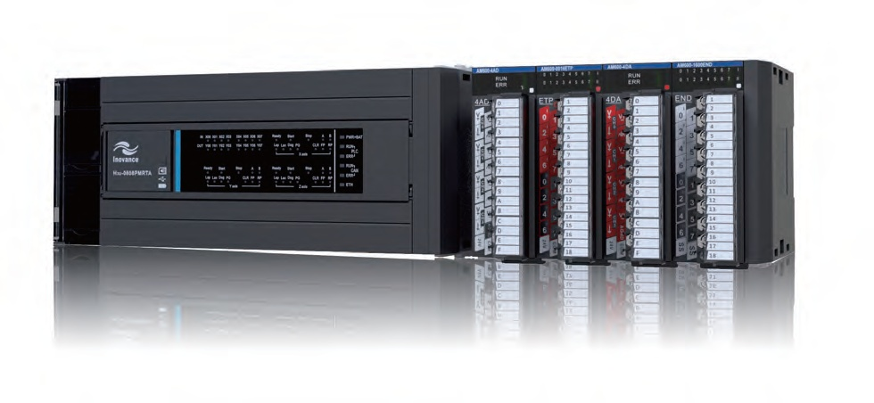
Servo | AC Drive | PLC | Motor | Robotic | IOT | Renewable Energy
H3U
PartⅠ
Marketing
H3U High Performance Small PLC
PMTS Eric Weng
Dec,2016
Version 1.0

Slide 2

CONTENTS
PART 1
Product Overview
PART 2
H3U Highlight
PART 3
System Application

Slide 3
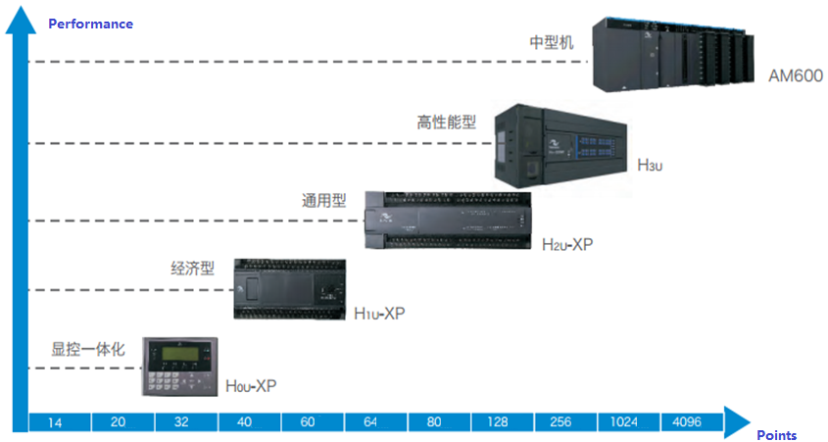

PART 1
Product Overview
Market Positioning
Performance
Medium
AM600
High performance
H3u
General
H2u
Economic
H1u
Integrative
H0u
Points

Slide 4
PART 1
Product Overview
Market Positioning
Small PLC
Market Positioning
High Performance
Easy to Use

Slide 5
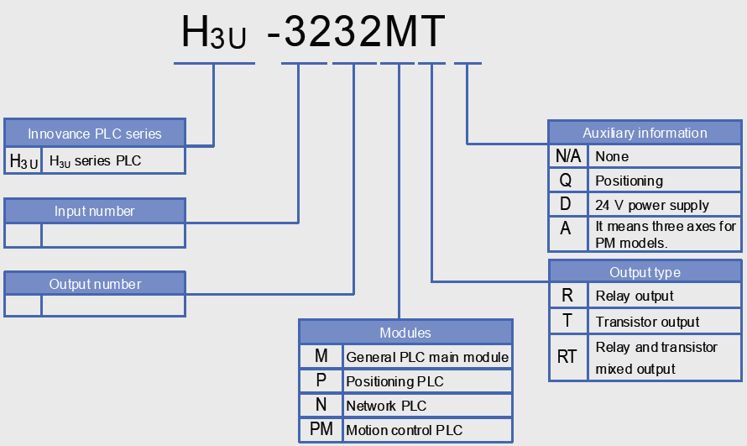
PART 1
Product Overview
Nameplate and Designation Rule
32
32 inputs
32
32 outputs

Slide 6
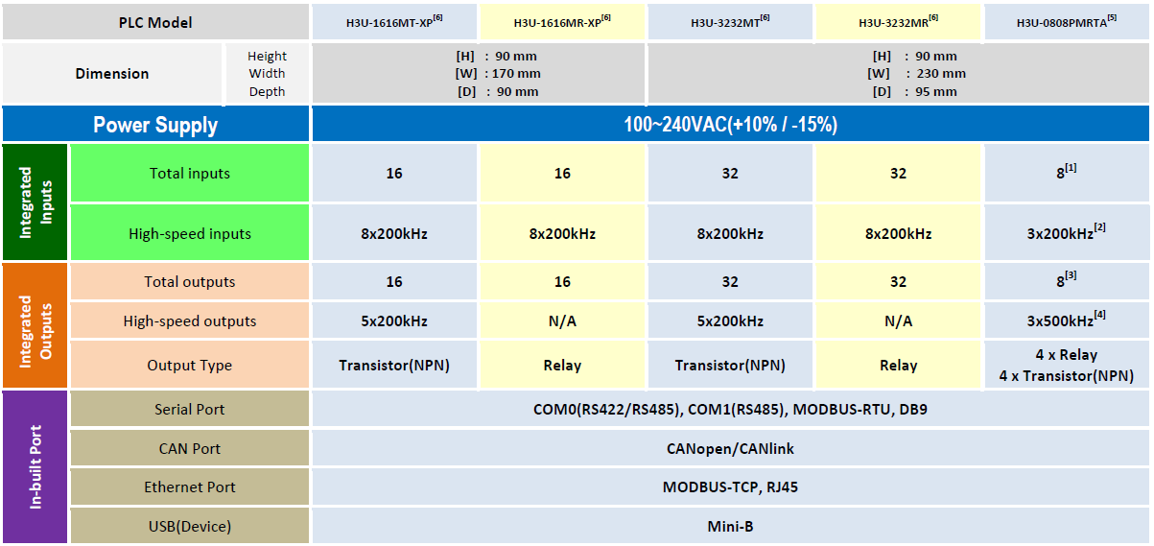
PART 1
Product Overview
Specifications

Slide 7
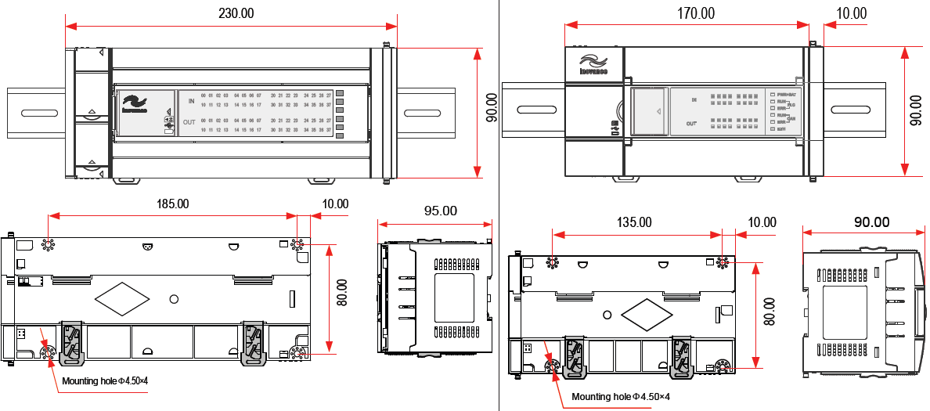
PART 1
Product Overview
Dimensions（unit：mm）
Dimensions of H3U-3232MT/R and H3U-0808PMRTA
Dimensions of H3U-1616MT/R-XP

Slide 8
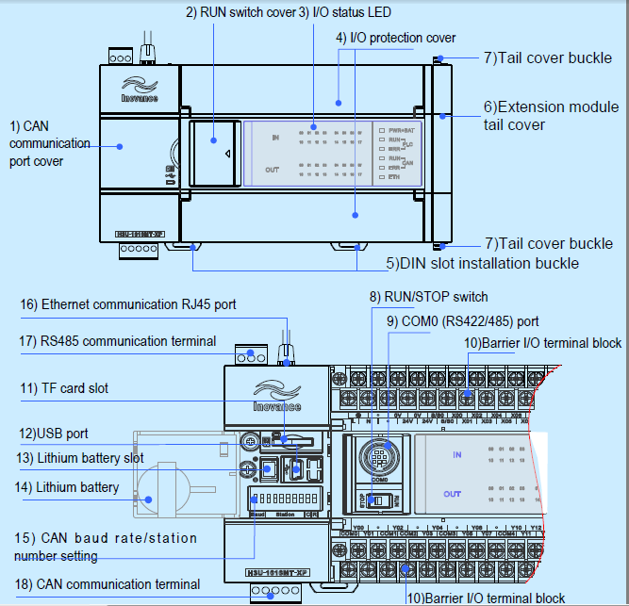
PART 1
Product Overview
Terminals Configuration
H3U-1616MT/R-XP

Slide 9
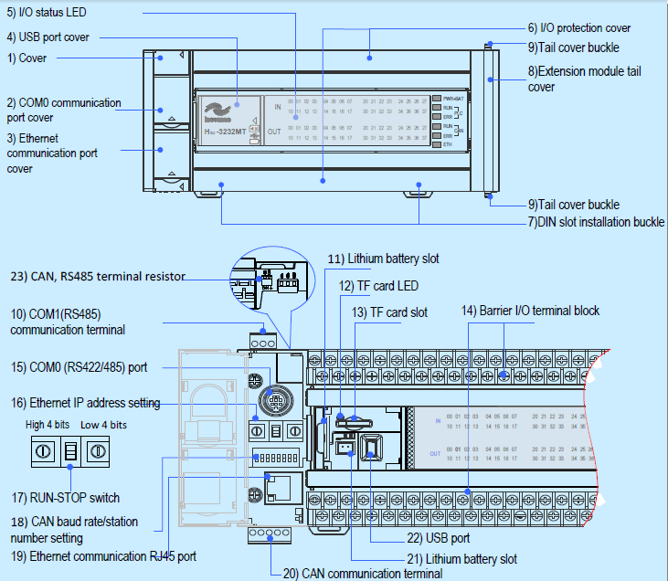
PART 1
Product Overview
H3U-3232MT/R or H3U-0808PMRTA

Slide 10
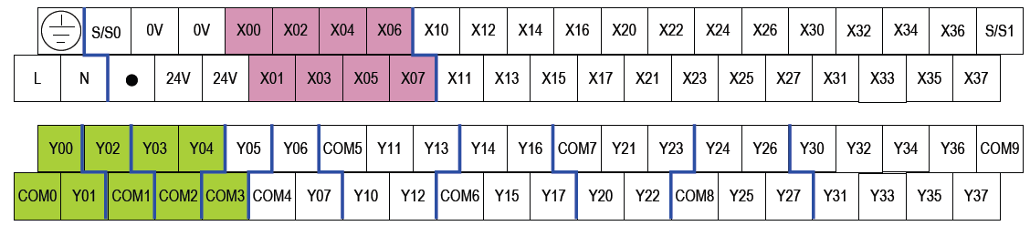
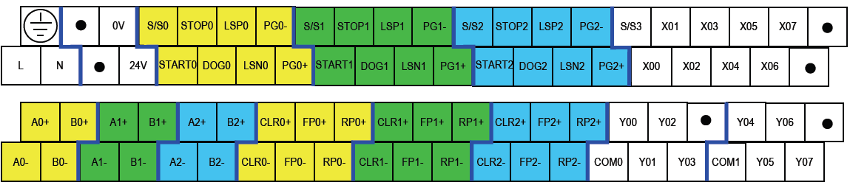
PART 1
Product Overview
Terminals of H3U-3232MT/R
Terminals of H3U-0808PMRTA

Slide 11
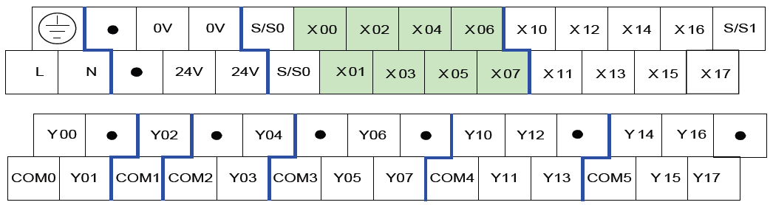
PART 1
Product Overview
Terminals of H3U-1616MT/R-XP

Slide 12
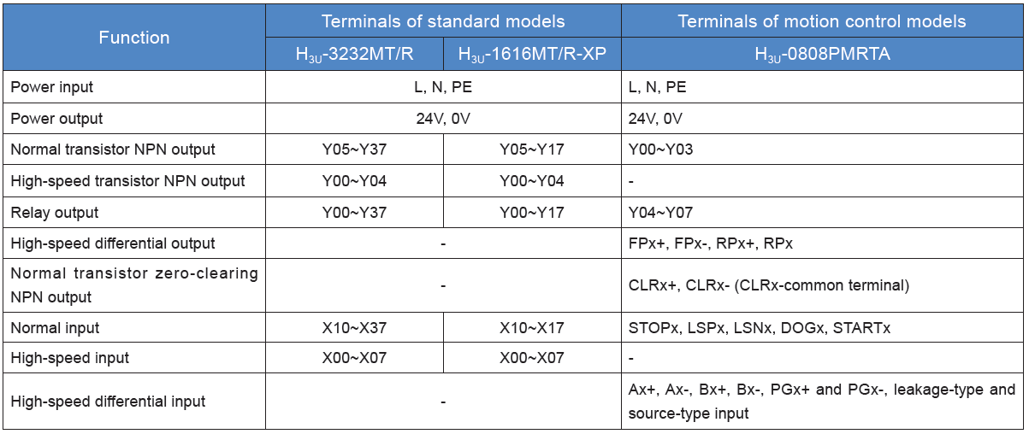
PART 1
Product Overview
Terminals Configuration

Slide 13
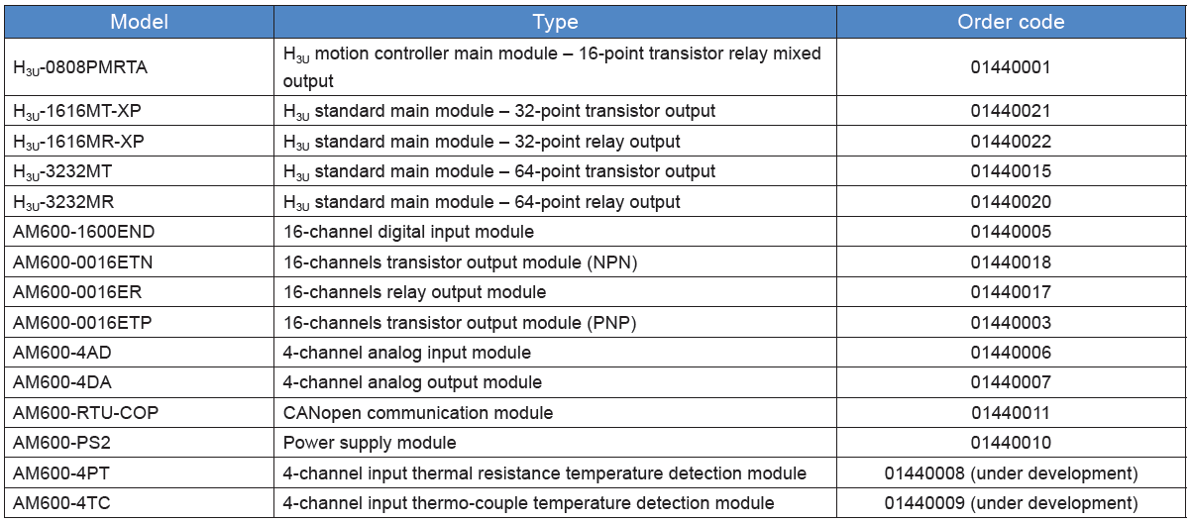
PART 1
Product Overview
Models

Slide 14


PART 2
Product Overview
Global Design Standards

Slide 15
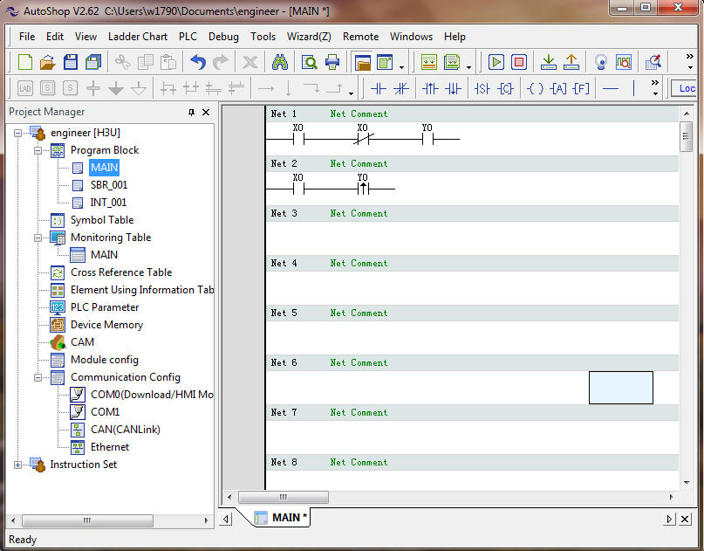
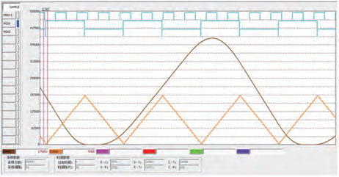

PART 1
Product Overview
PC-Based Software
PC-based software-AutoShop can achieve the PLC programming，parameters upload, download, real-time oscilloscope and other functions.
Programming language：
ladder、instruction list、SFC
Operating in Win7\WinXP

Slide 16
CONTENTS
PART 1
Product Overview
PART 2
H3U Highlight
PART 3
System Application

Slide 17
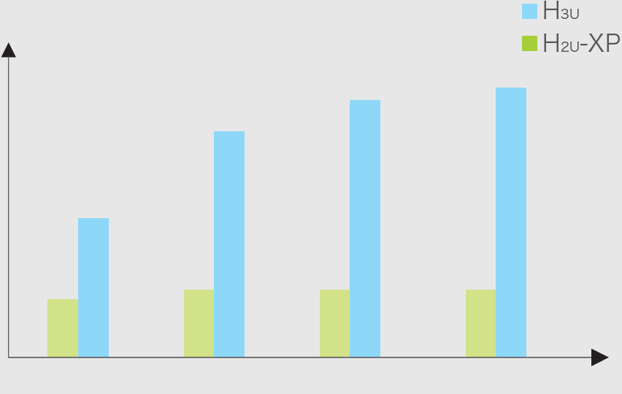
PART 2
H3U Highlight
High Performance and large Capacity
All-in-one CPU, power supply and I/O
Basic instruction: 100ns/instruction
Program capacity: 64K steps
Device memory
• Auxiliary Relays 9216 points
• Timers 512 points
• Counters 256 points
• Data Registers 9552 points
• File Registers 32768 points
High-speed inputs: 200kHz
High-speed outputs: 200kHz(Standard Model) 500kHz(Motion Control Model)
Execution
speed
Program
Capacity
Data
Capacity
High Pulse
Capacity

Slide 18
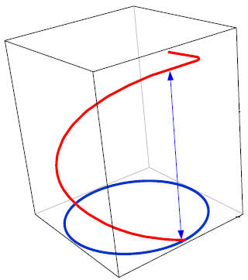
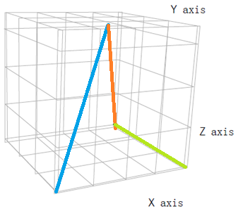
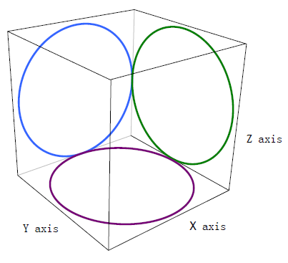
PART 2
H3U Highlight
Powerful Motion Control
Two-axis arc
interpolation
Three-axis straight line
interpolation
Three-axis spiral
interpolation

Slide 19
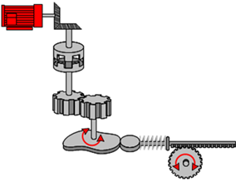
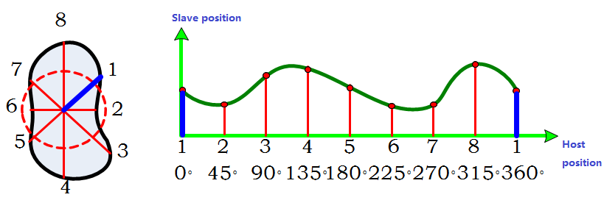
PART 2
H3U Highlight
Powerful Motion Control
Three-axis electronic cam replaces the mechanical cam, more flexible and low cost
Mechanical Cam
E- Cam

Slide 20
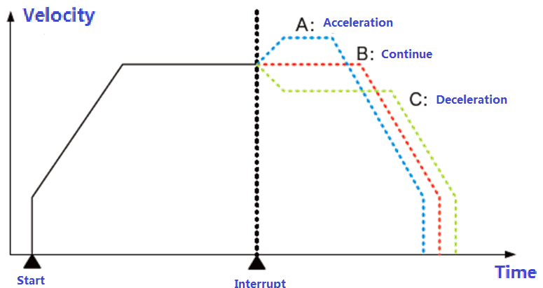
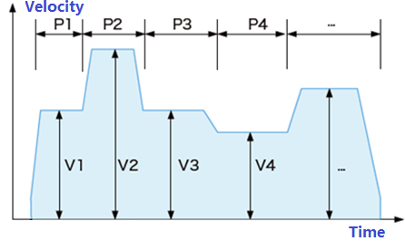
PART 2
H3U Highlight
Powerful Motion Control
Multi-Position Location
Interruption Control

Slide 21
PART 2
H3U Highlight
Rich Network Solution
Economic bus
Modbus-TCP
ModbusRTU-RS485
CANopen
Double CPU Design
Pulse location and High Speed Interruption

Slide 22
CONTENTS
PART 1
Product Overview
PART 2
H3U Highlight
PART 3
System Application

Slide 23
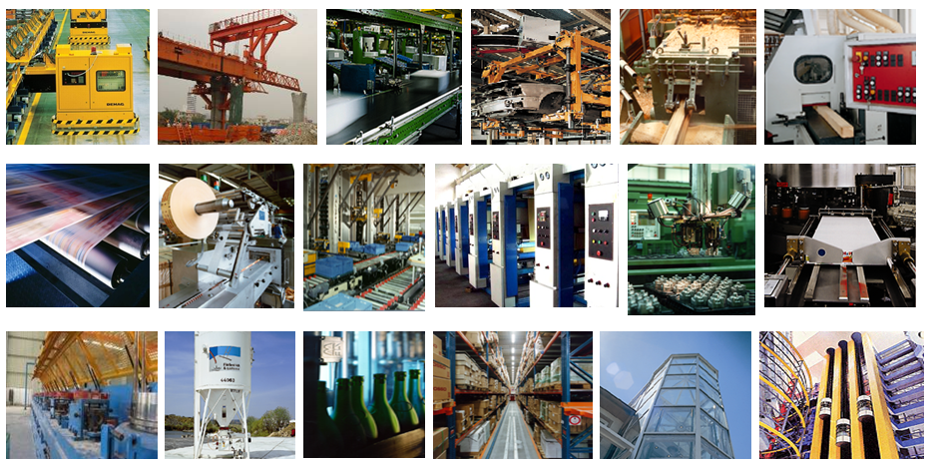
PART 3
System Application
Application Industry
Crane
Glass
Wood
Conveyor Belt
Textile
Package
Print
Machine Tool
Cable
Package
Air-condition
Elevator

Slide 24
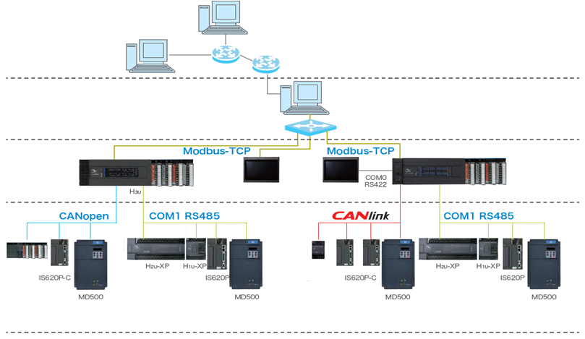
PART 3
System Application
Typical Application Network
Management layer
WAN
Operation layer
Control layer
HMI
I/O
I/O
Execution layer

Slide 25
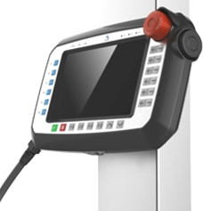
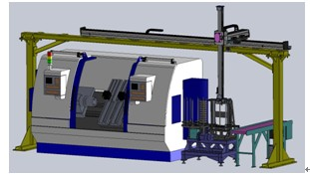
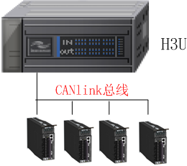
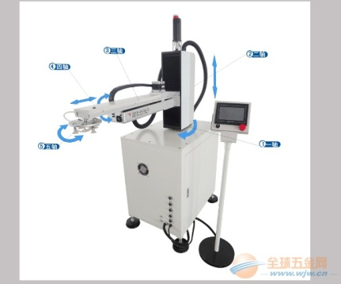
PART 3
System Application
Application In Machine Feeding
The scheme realizes machine feeding system, using path planning function of H3u to achieve trajectory planning, logical planning
HMI
CANlink

Slide 26
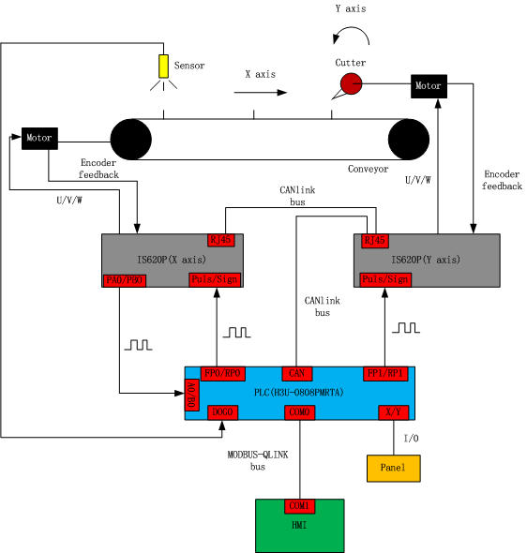
PART 3
System Application
Application In Rotary Cutting
H3u controls the X axis to drive the conveyor to feed the material, controls the Y axis to drive the cutter to circle, counts the pulses output by X axis to calculate the on-going convey distance. E-CAM function of H3u describes the running distance relationship between the X and Y axis.

Slide 27


THANK YOU

